Slide 1
COMPS450 Applied Computing Project
A DOCUMENT PROCESSING SOLUTION FOR THE LOGISTICS INDUSTRY
Group members:
1155180 (BCOMPHIT1 - Yip Pik Ying)
1265005 (BSCHCN - Chan Chi Hung)
1284810 (BCOMPHIT1 - Andy Lau)

Slide 2
The Problem and the Project Aim
Domain
Import & Export Logistics
Background
Data security is important for business platforms. Only based on sequential booking number to extract booking data is highly security risk. Manual Input also increase security risk due to wrong input.
Problem
Low Data Security on Booking Data Extraction in Logistics Electronic Import/Export Platform
Project Aim
Develop a document processing solution to reduce manual, repetitive input tasks among collaborating parties and enhance data security.

Slide 3
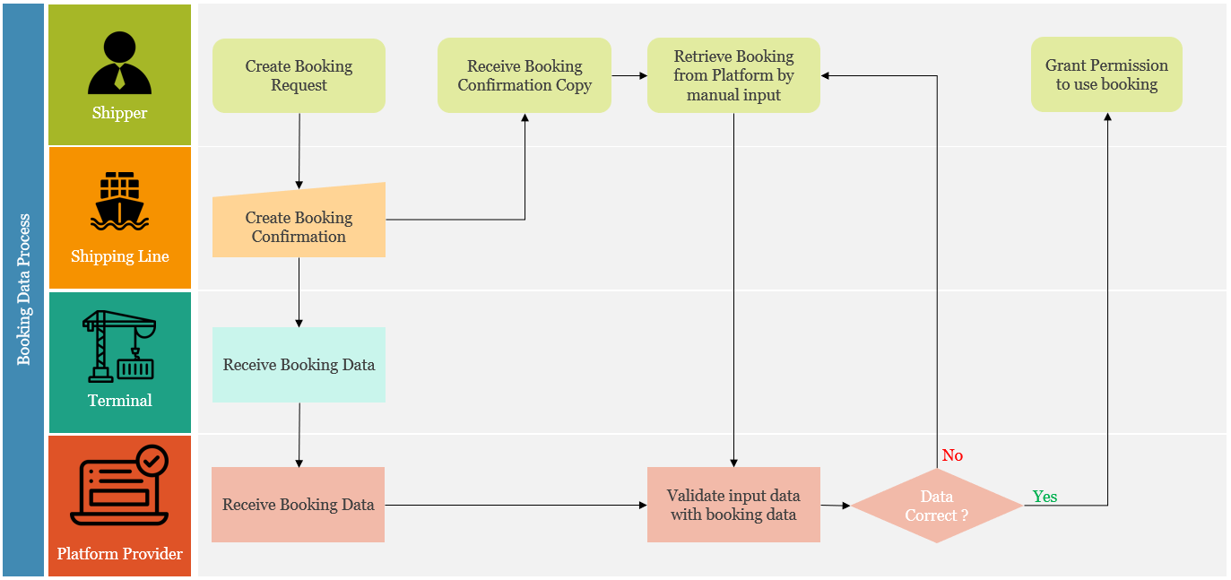
Justification 1: Background

Slide 4

Justification 1: Background
User manual input the key information
Pros:
No need other parties involved
Easy to use
Cons:
Data security issue Since booking no. is sequential, so user can guess other valid booking no.
Poor error handling Human mistakes may require repetitive input

Slide 5



Justification 2: Existing Solutions
Solution 1
Solution 2
Solution 3
Request shipping line to send unique ID to both shipper and terminal.
Request shipping line to provide a field for shipper input their company ID when request booking and send to the terminal.
Request shipper to input more information to retrieve booking.
Most secure data
Company ID also secure data
Increase data security
Require shipping line system change
Require shipping line system change
No need shipping line system change
Require education shipper to use new unique ID
Difficult to handle if user input wrong company ID
Require shipper more knowledge
Poor user experience

Slide 6

Justification 3: Existing Technologies
Automated Document Processing SaaS / software
Document processing SaaS - The Big-three public cloud providers
Google Cloud - Document AI
Microsoft Azure - AI Document Intelligence
Amazon AWS - Intelligent Document Processing
AI Powered OCR software - e.g. vDigiDocr (Bhatt, 2022)
mixture of existing AI techniques
process all kinds of documents, the software surpasses most of the current models and software in the market.
Bhatt, A. (2022) Document Automation Using Artificial Intelligence.

Slide 7
Justification 3: Existing Technologies
Reasons for not choosing these market available software / SaaS
Commericial, Low-code/No-code solutions
Against data governance policy
Black-box. We can’t figure out the details of their hidden models
Expect greater flexibility on tuning and learning opportunity

Slide 8
Justification 3: Existing Technologies
Machine learning - deep learning
Use of deep learning model (CNN, RNN) to build our model from scratch
Constraints - dataset, training time, GPU…etc.
If you can’t beat them, join them → Tuning a pre-trained transformer-based models from Big Tech
Existing AI models or techniques related to our projects
YOLOv8 - AI model for image detection
DocBERT - AI model for document classification (Adhikari et al., 2019)
LayoutLM - AI model for document understanding with OCR (Xu et al., 2020)
Donut - AI model for document understanding without OCR (Kim et al., 2021)
Adhikari, A., Ram, A., Tang, R., & Lin, J. (2019). Docbert: Bert for document classification. arXiv preprint arXiv:1904.08398.
Kim, G., Hong, T., Yim, M., Park, J., Yim, J., Hwang, W., ... & Park, S. (2021). Donut: Document understanding transformer without ocr. arXiv preprint arXiv:2111.15664, 7, 15.
Xu, Y., Li, M., Cui, L., Huang, S., Wei, F., & Zhou, M. (2020, August). Layoutlm: Pre-training of text and layout for document image understanding. In Proceedings of the 26th ACM SIGKDD International Conference on Knowledge Discovery & Data Mining (pp. 1192-1200).

Slide 9
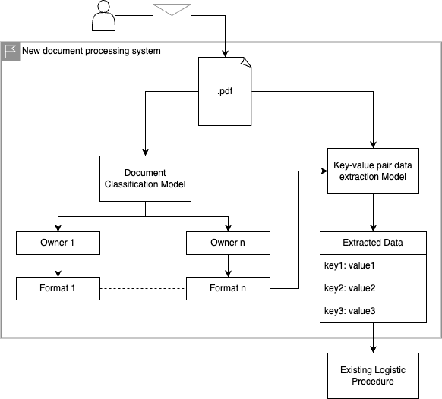
Project Objectives
Develop a new document processing system, which provides :
Document Classification
Key-value Pair Data Extraction from Document
Result: input essential information to existing logistic procedure

Slide 10
Project Objectives
Document Classification
Verifying the document
data security
Determining the format of the document
5 <= n <= 10
Classified by the characteristics
Company Logo - YOLOv8
Content - DocBert

Slide 11
Project Objectives
Key-value Pair Data Extraction from Document
Simular with Documnet AI solutions of huge IT companies
Essential information in document
booking number
Pre-trained models
LayoutLM
Dount

Slide 12
END

Slide 13
References
Adhikari, A., Ram, A., Tang, R., & Lin, J. (2019). Docbert: Bert for document classification. arXiv preprint arXiv:1904.08398.
Bhatt, A. (2022) Document Automation Using Artificial Intelligence.
Kim, G., Hong, T., Yim, M., Park, J., Yim, J., Hwang, W., ... & Park, S. (2021). Donut: Document understanding transformer without ocr. arXiv preprint arXiv:2111.15664, 7, 15.
Vaswani, A., Shazeer, N., Parmar, N., Uszkoreit, J., Jones, L., Gomez, A. N., ... & Polosukhin, I. (2017). Attention is all you need. Advances in neural information processing systems, 30.
Xu, Y., Li, M., Cui, L., Huang, S., Wei, F., & Zhou, M. (2020, August). Layoutlm: Pre-training of text and layout for document image understanding. In Proceedings of the 26th ACM SIGKDD International Conference on Knowledge Discovery & Data Mining (pp. 1192-1200).

